Slide 1
Front End Engineering-I Project
G-15/PG-13
Sejal Bansal Roll No: 2310991208
Shivam Jaswal Roll No: 2310991209
Shivanshi Jain Roll No: 2310991210
Shivika Roll No: 2310991211
Faculty Coordinator: Mrs. Gaganpreet Kaur
:
Chitkara University Institute of Engineering and Technology,
Chitkara University, Punjab

Slide 2
Table of Contents
Introduction
Problem Statement
Features
Technologies Used
Bonus Feature
Project Highlights
Conclusion
References/Links used

Slide 3
Introduction
Word Counter - A Text Analysis Tool. This powerful instrument goes beyond mere word counting; it empowers writers, researchers, and data analysts to delve into text, offering insights through character analysis and extraction. Uncover the depth of your content with our versatile tool, streamlining the way you approach text analysis.

Slide 4
Problem Statement
In a world increasingly driven by textual data, there is a growing need for an efficient and user-friendly tool that can accurately count words, characters, and provide valuable insights into textual content.
Our project aims to address these challenges by developing a comprehensive 'Word Counter' tool that offers precise word and character counting, analysis features. This tool will cater to the diverse needs of students, writers, researchers, and professionals who rely on textual content, enhancing their efficiency, accuracy, and productivity in handling and analyzing text-based information.

Slide 5
Features
Word Counting:
Accurately counts the number of words in the provided text, aiding writers and editors in meeting word count requirements.
Character Analysis:
Goes beyond word counting to provide insights into character usage, helping users understand text composition.
Real-time Updates:
Dynamically updates word and character counts as users type, ensuring instant feedback and a seamless writing experience.
Responsive Design:
Ensures a user-friendly experience on various devices by employing responsive design principles with HTML, CSS, and JavaScript.
Clear Visualization:
Presents results in a visually clear format, making it easy for users to interpret and analyze the textual data.
Copy-Paste Functionality:
Supports effortless text input through copy-paste, streamlining the process for users working with existing content.

Slide 6
User-Friendly Interface:
Designed with simplicity in mind, the interface is intuitive and accessible to users with varying levels of technical expertise.
Lightweight and Fast:
Optimized for performance, ensuring quick and efficient word counting without unnecessary delays.
Cross-Browser Compatibility:
Compatible with major web browsers, ensuring a consistent and reliable experience for users across different platforms.
These features collectively make the Word Counter a versatile and indispensable tool for writers, researchers, and anyone requiring precise text analysis.

Slide 7
Technical Details
Technologies and methods used
1. HTML (Hypertext Markup Language):
HTML is used to structure the web page and create elements like text areas, headings, and spans for displaying the word count.
2. CSS (Cascading Style Sheets):
CSS is employed for styling the web page, making it visually appealing and user-friendly. It's used to format text, define layout, and enhance the overall design. It can be used to create responsive designs for various screen sizes.
3. User Interaction:
Users input text into a text area provided in the HTML interface.
4. JavaScript: JavaScript forms the backbone of the Word Counter's functionality, enabling dynamic and interactive features. It facilitates real-time word counting and enhances the user experience by incorporating client-side scripting.
.

Slide 8
Bonus Feature
RESPONSIVENESS
Optimized for all Devices
Our website adapts seamlessly to desktops, tablets, and mobile phones
Enhanced User Experience.
Ensuring a consistent and user-friendly experience, regardless of the screen size
Improved Accessibility
Accessible to a wider audience, promoting inclusivity.

Slide 9
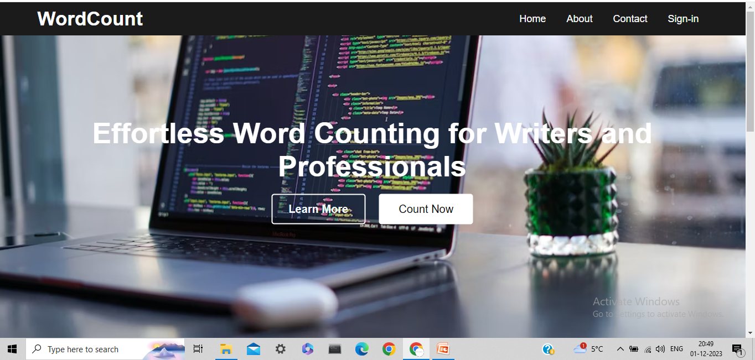
Project Highlights
FRONT PAGE

Slide 10
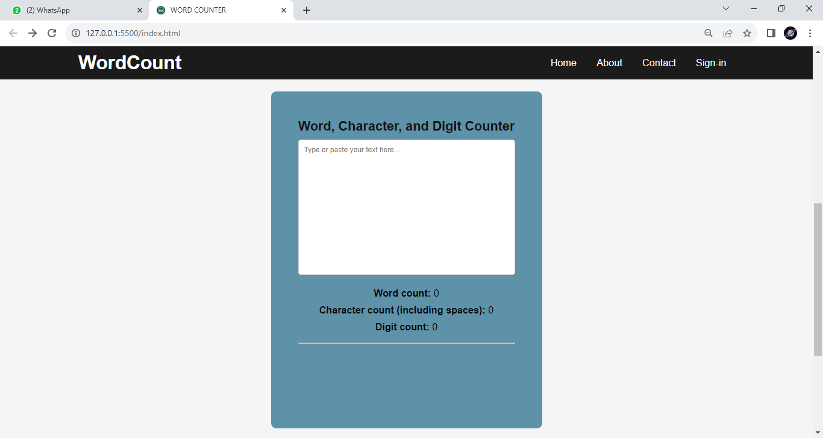

Slide 11
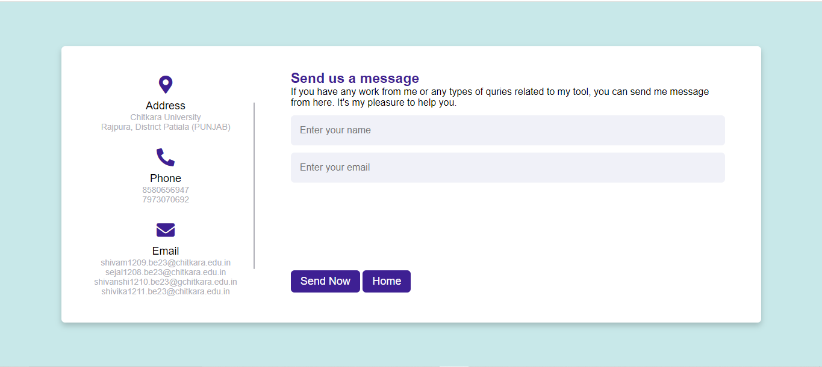
Contact Us Page

Slide 12
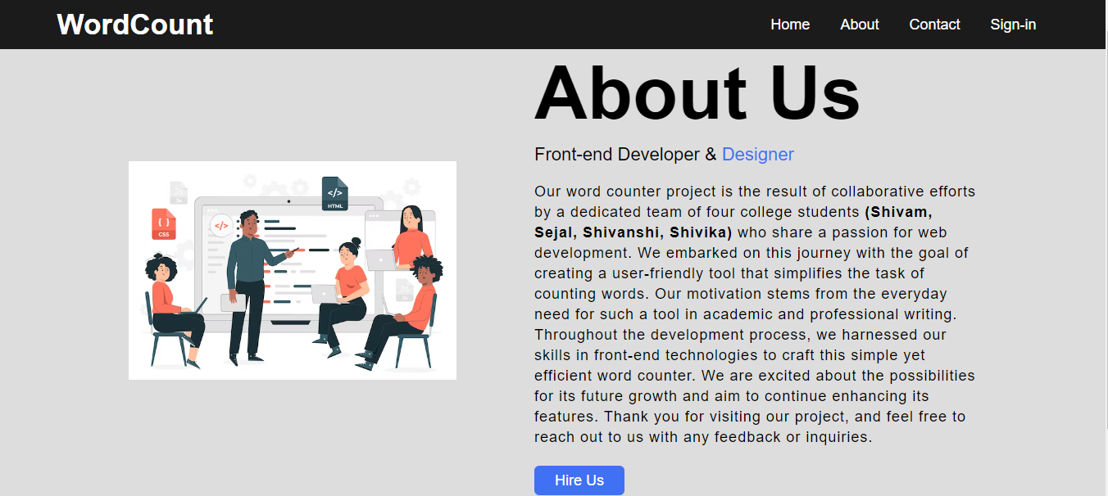
About Us Page :

Slide 13
Conclusion
Key Points of the Project
1. Word Count Accuracy: The tool accurately counts words in a wide range of document formats, ensuring precision in various writing and analytical tasks.
2. User-Friendly Interface: The user interface is intuitive and easy to navigate, making it accessible to users with varying levels of technical expertise.
3. Efficient Processing: The tool processes large documents quickly, saving users time and effort when analyzing lengthy texts.
4. Compatibility: It is compatible with multiple file formats, including DOC, DOCX, PDF, and plain text files, making it versatile and widely usable.
5. Customization Options: Users have the flexibility to customize settings, such as excluding certain words or characters, tailoring the tool to their specific needs.

Slide 14
Team’s Main Takeaways
1. Collaboration: The project emphasized the importance of effective teamwork, with each team member contributing their unique skills and expertise to achieve the common goal.
2. Problem Solving: Overcoming technical challenges during development taught the team the value of creative problem-solving and persistence.
3. User-Centered Design: Prioritizing user feedback and designing a user-friendly interface reinforced the significance of user-centered design principles.
4. Quality Assurance: Rigorous testing and validation processes underscored the importance of quality assurance in ensuring the tool's accuracy and reliability.
5. Continuous Improvement: The project highlighted the need for ongoing development and improvements, with the team committed to enhancing the tool based on user feedback and emerging needs.

Slide 15
References/Links used
Google.com (https://www.google.com/)
W3Schools(https://www.w3schools.com/)
Wikipedia (https://www.wikipedia.org/)
Word Counter (https://wordcounter.net/)
Background Image (https://images.unsplash.com/photo-1587620962725-abab7fe55159?ixlib=rb-1.2.1&ixid=MnwxMjA3fDB8MHxwaG90by1wYWdlfHx8fGVufDB8fHx8&auto=format&fit=crop&w=1031&q=80 )

Slide 16


